Slide 1
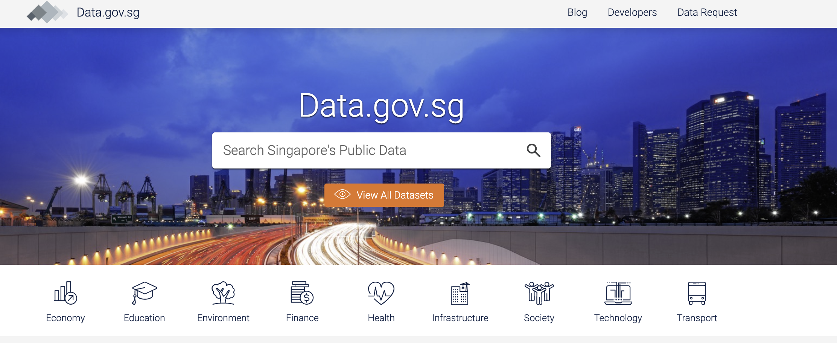

Real time taxi monitoring project

Slide 2
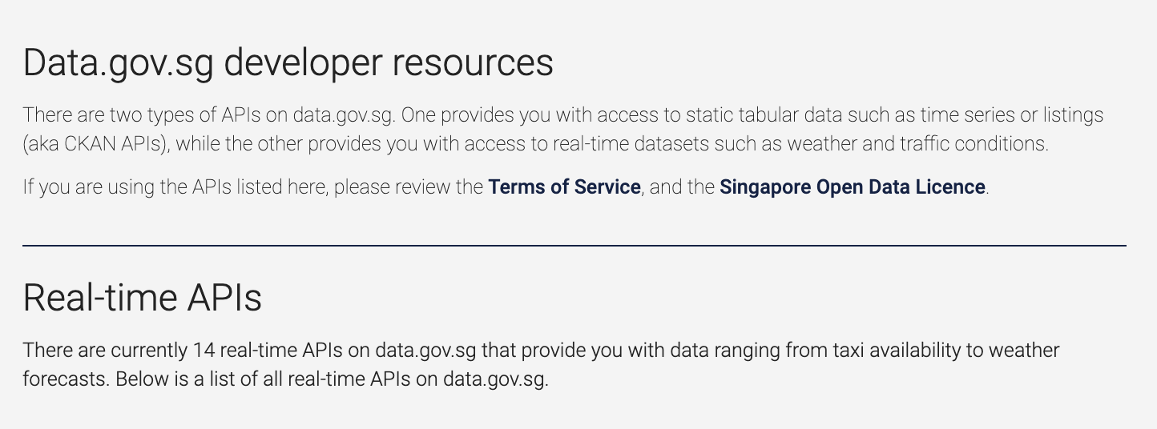
Real time taxi monitoring project
Objective
Analyze real time taxi data using data.gov.sg
Package
Folium for geospatial plots
Data source
Updated every 30seconds by data.gov.sg.
Map plot
Create API to pull every 60 seconds
Automatically plot map when new data is in.

Slide 3
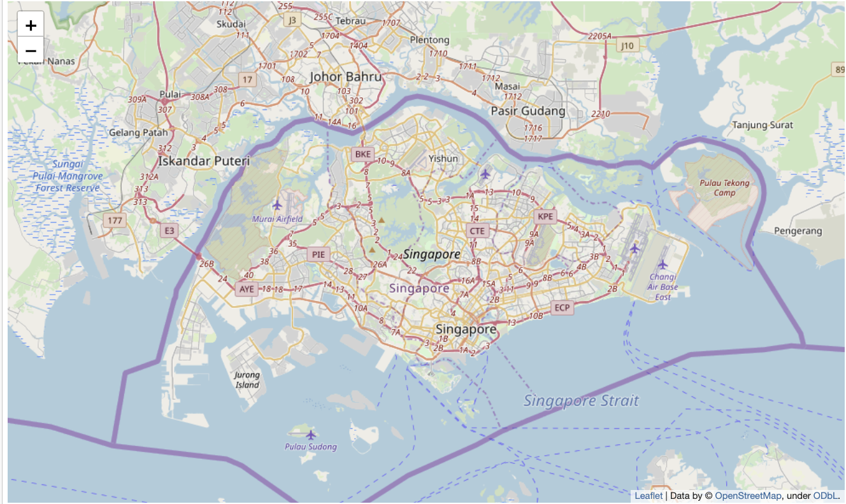
Folium plug-in Singapore map
Monday morning 9.50am

Slide 4
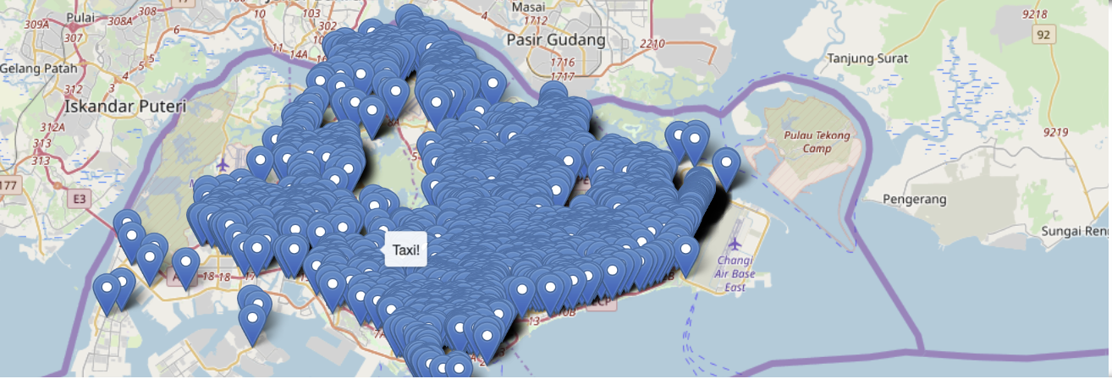
Available taxis island-wide
Monday morning 9.50am

Slide 5
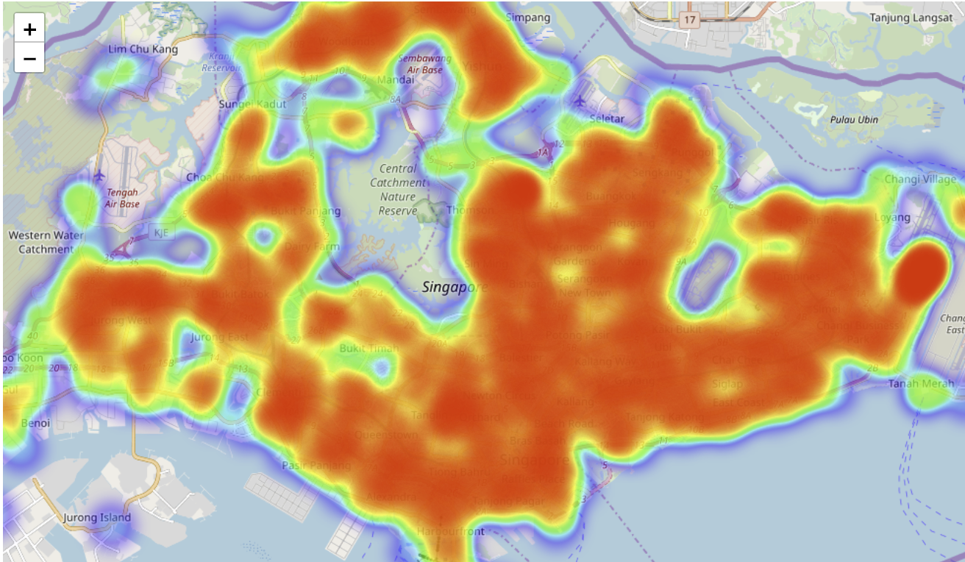
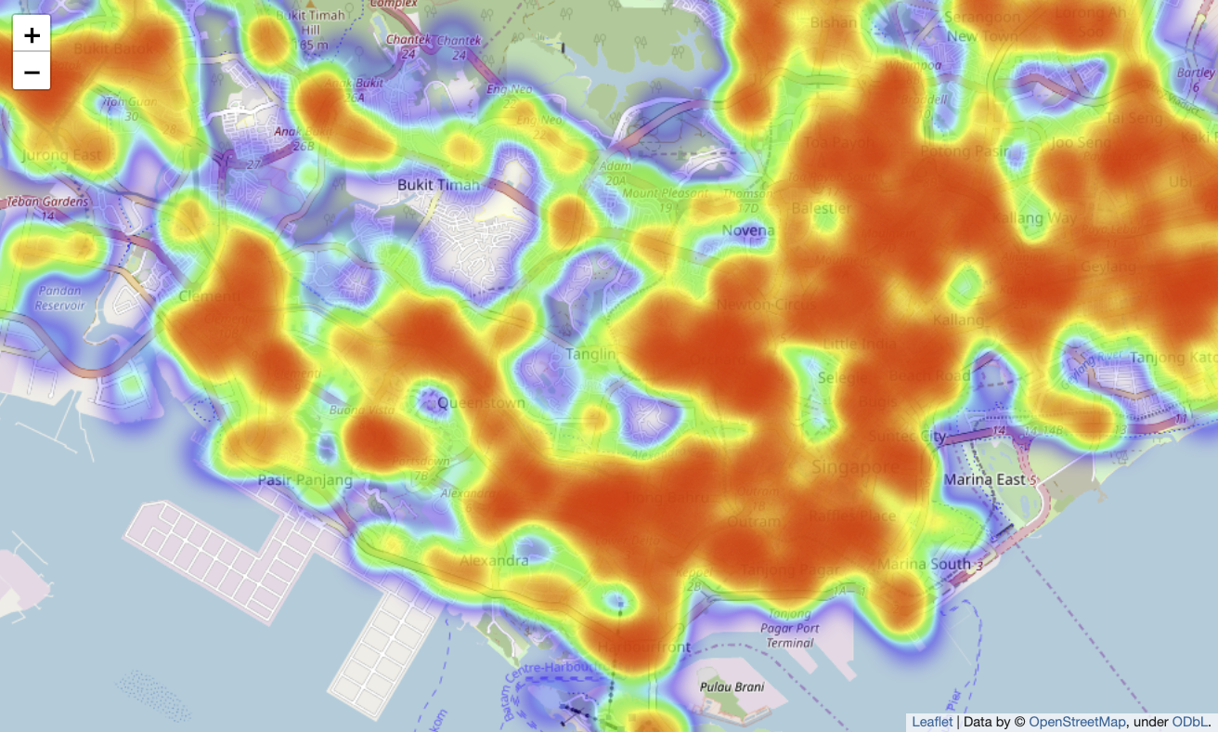
Heat map of taxi availability island-wide

Slide 6
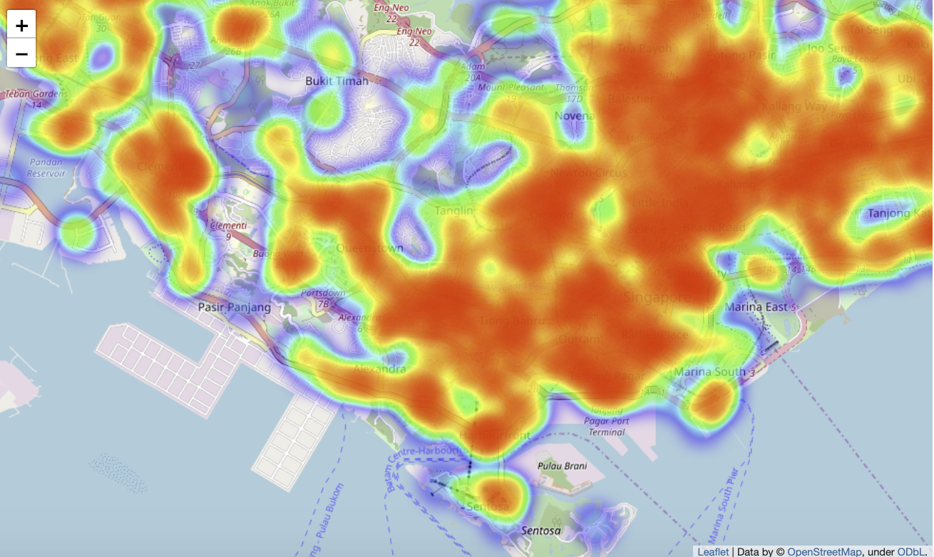
Real time taxi monitoring project
Sunday afternoon
Monday morning
Better taxi coverage on Monday as compared to sunday

Slide 7
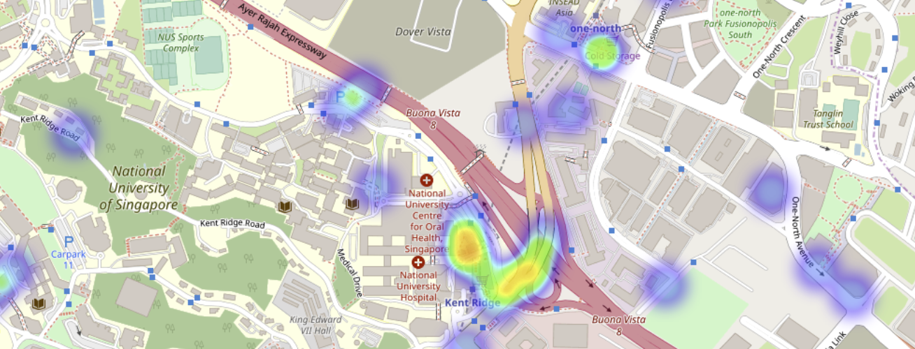
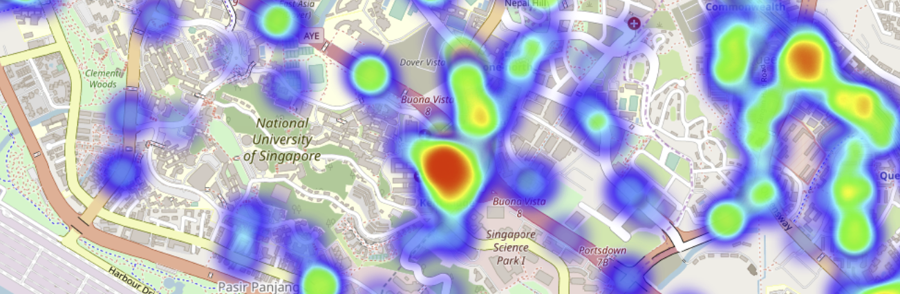
Kent ridge taxi situation
Sunday afternoon 3pm
Monday morning 10am
Higher taxi coverage in the NUH on Mondays.

Slide 8
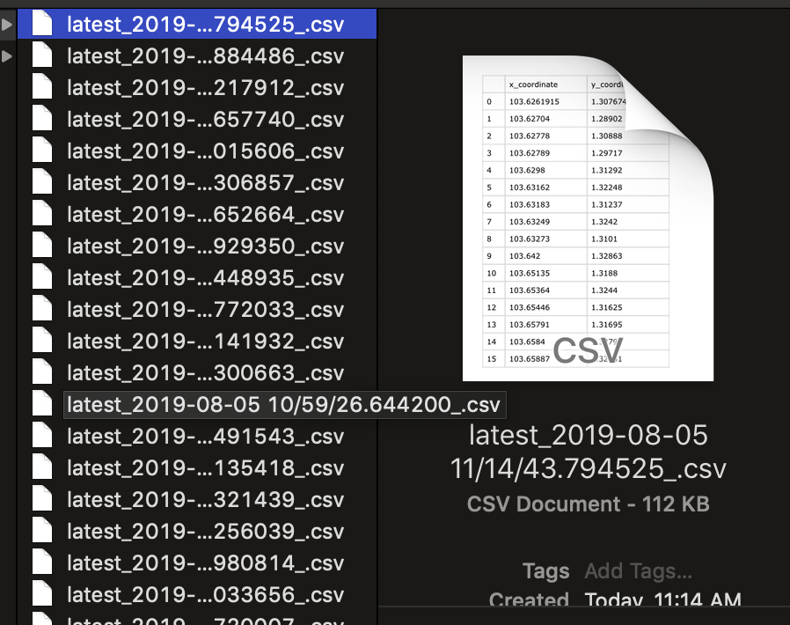
Real time taxi monitoring project
Storage of real time data into computer

Slide 9
Summary
Data can be analyzed via over a period or at specific times of the day to analyze taxi service over the whole country.
Business questions
Can some areas be better served?
Are there areas underserved?
Can be applied to weather, air quality, schools from data.gov.sg or data.gov

